Slide 1
Day 2: Data Visualization

Slide 2
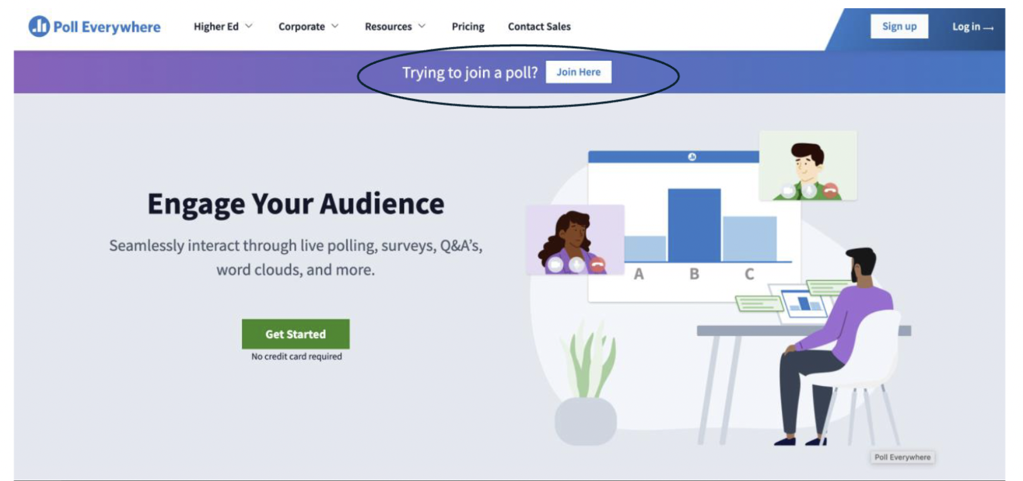
Joining polleverywhere
Go to www.polleverywhere.com

Slide 3
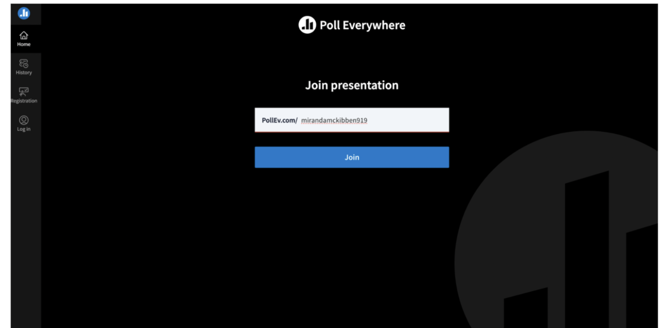

Slide 4
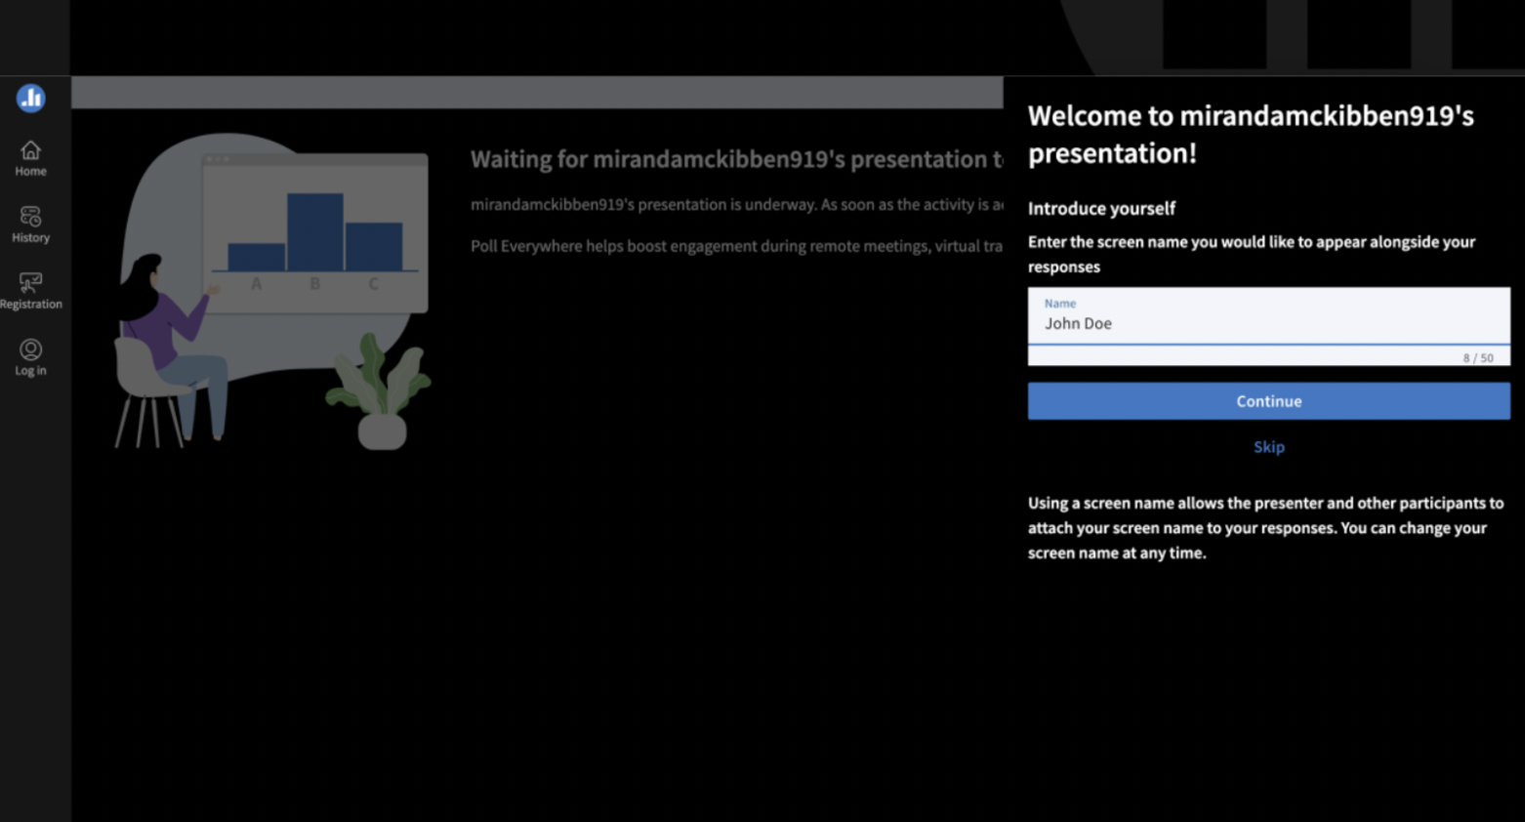

Slide 5
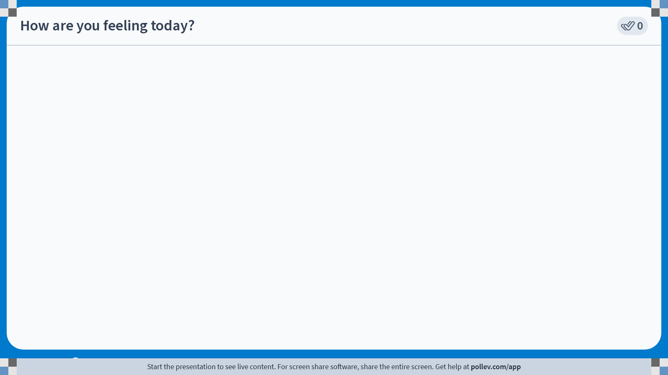
Notes:
Do not modify the notes in this section to avoid tampering with the Poll Everywhere activity. More info at polleverywhere.com/support How are you feeling today?
https://www.polleverywhere.com/clickable_images/AQh790iZU74m5SY8hmSYd

Slide 6
Goal of today’s class
Identify whether a variable is continuous or categorical
Practice making plots and figures in RStudio

Slide 7
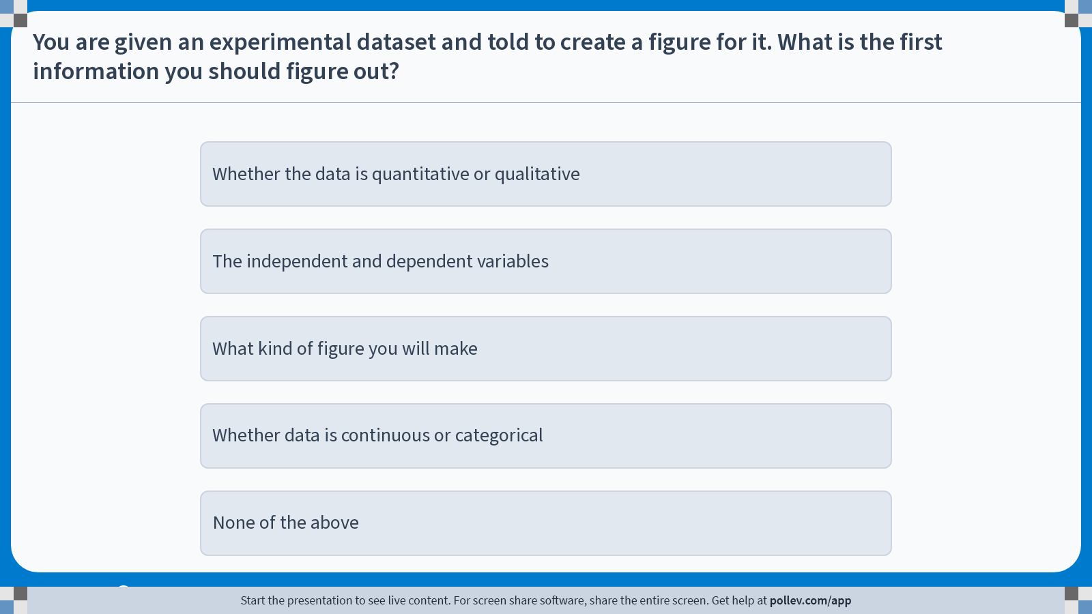
Notes:
Do not modify the notes in this section to avoid tampering with the Poll Everywhere activity. More info at polleverywhere.com/support You are given an experimental dataset and told to create a figure for it. What is the first information you should figure out?
https://www.polleverywhere.com/multiple_choice_polls/qskPapdvFX6btR53BArX5?display_state=instructions&activity_state=opened&state=opened&flow=Engagement&onscreen=persist

Slide 8
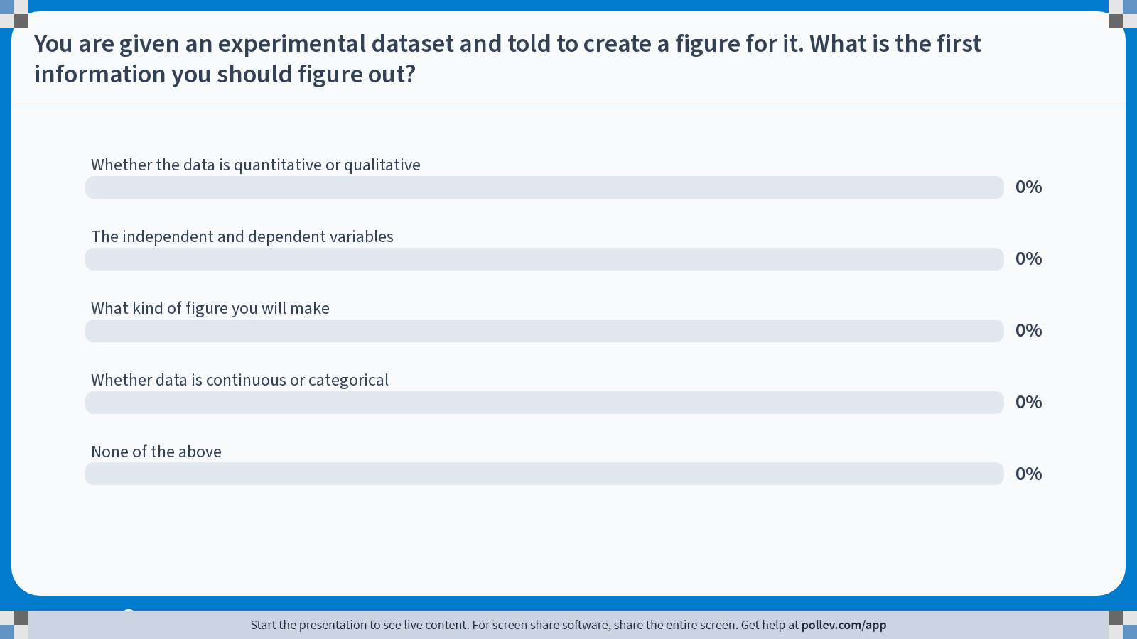
Notes:
Do not modify the notes in this section to avoid tampering with the Poll Everywhere activity. More info at polleverywhere.com/support You are given an experimental dataset and told to create a figure for it. What is the first information you should figure out?
https://www.polleverywhere.com/multiple_choice_polls/qskPapdvFX6btR53BArX5?display_state=chart&activity_state=opened&state=opened&flow=Engagement&onscreen=persist

Slide 9
Notes:
Do not modify the notes in this section to avoid tampering with the Poll Everywhere activity. More info at polleverywhere.com/support You are given an experimental dataset and told to create a figure for it. What is the first information you should figure out?
https://www.polleverywhere.com/multiple_choice_polls/qskPapdvFX6btR53BArX5?display_state=chart&activity_state=closed&state=closed&flow=Engagement&onscreen=persist

Slide 10
The first step in graphing is identifying your variables
Independent Variable (x-axis)
A variable whose value does not depend on any variable (independent)
Think of it as the “cause” in experimental research
Example: abiotic factors (temperature, salinity, food, O2)
Dependent Variable (y-axis)
A variable whose value does depend on the manipulation of another variable (dependent)
Think of it as the “effect” in experimental research
Example: biotic responses (movement, growth, reproduction)

Slide 11
Step 2: Are your variables qualitative or quantitative?
Qualitative variables
Descriptions, language or text rather than numbers
Usually needs to be categorized
Examples:
How do students feel about each course?
What do the tree leaves look like over time?
Quantitative variables
Numerical
Quantifiable, more precise
Examples:
How many students are in each course?
How does tree height change over time?

Slide 12
Step 3: Is your independent variable categorical or continuous?
Categorical
Data can be assigned to discrete groups or categories
Organism based: species, color, leaf shape, etc.
Treatment based: fertilized vs. unfertilized, experimental drug vs. placebo, etc.
Continuous
Data is numeric with an infinite number of possible values
Organism based: height, weight, age, etc.
Treatment based: nutrient concentration, time, amount of daylight, temperature, etc.

Slide 13
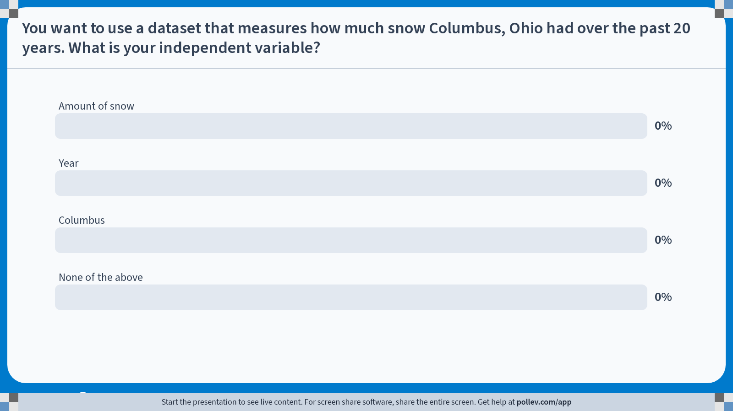
Notes:
Do not modify the notes in this section to avoid tampering with the Poll Everywhere activity. More info at polleverywhere.com/support You want to use a dataset that measures how much snow Columbus, Ohio had over the past 20 years. What is your independent variable?
https://www.polleverywhere.com/multiple_choice_polls/agSkTPUN30VAmdZIWy9lm?state=opened&flow=Default&onscreen=persist

Slide 14
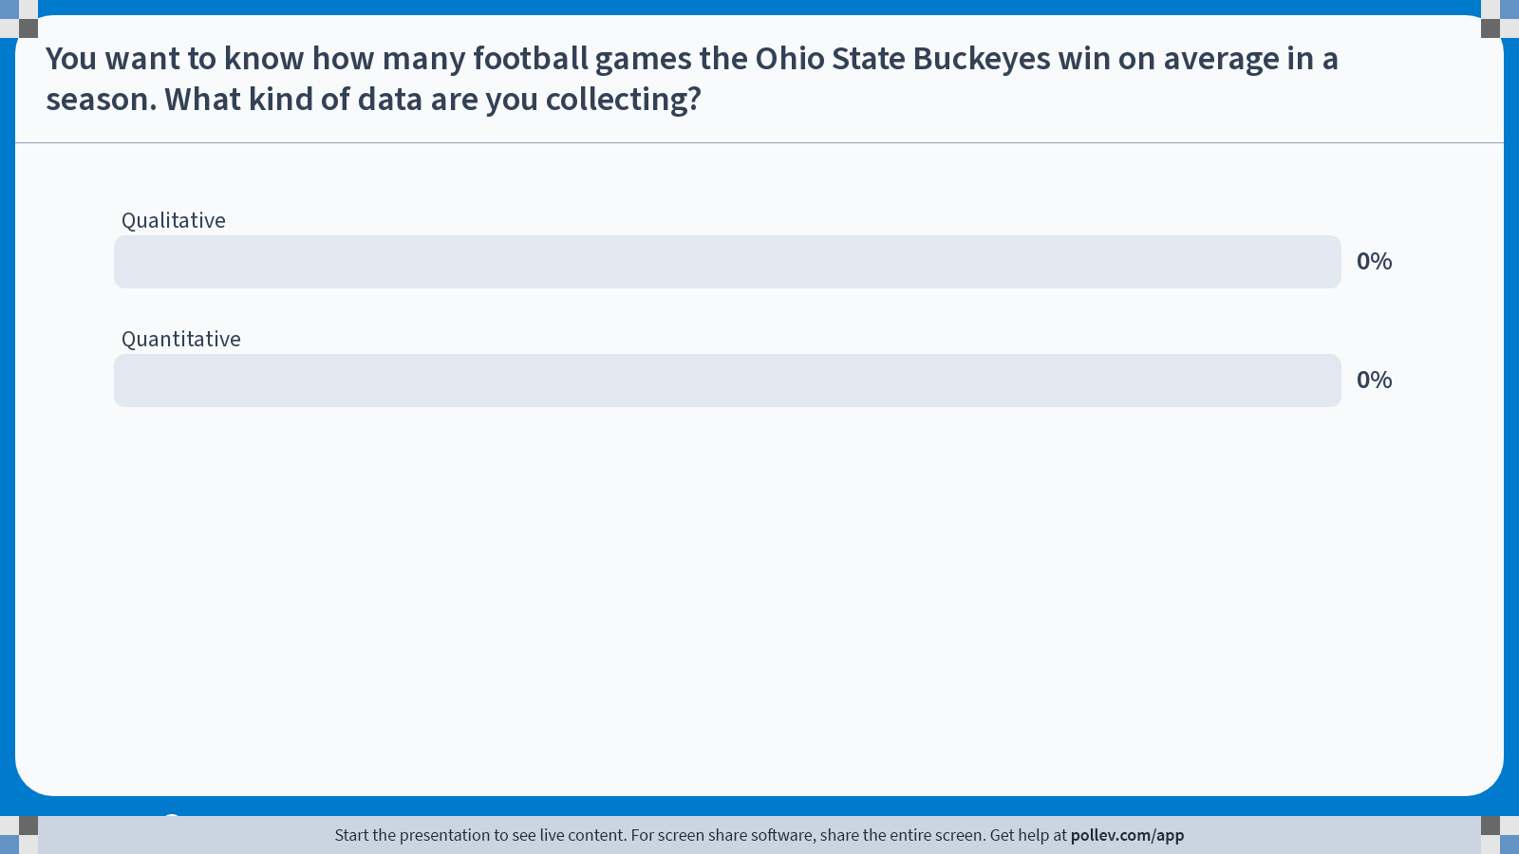
Notes:
Do not modify the notes in this section to avoid tampering with the Poll Everywhere activity. More info at polleverywhere.com/support You want to know how many football games the Ohio State Buckeyes win on average in a season. What kind of data are you collecting?
https://www.polleverywhere.com/multiple_choice_polls/RQkmrUIjYt9lFEe94k6DU?state=opened&flow=Default&onscreen=persist

Slide 15
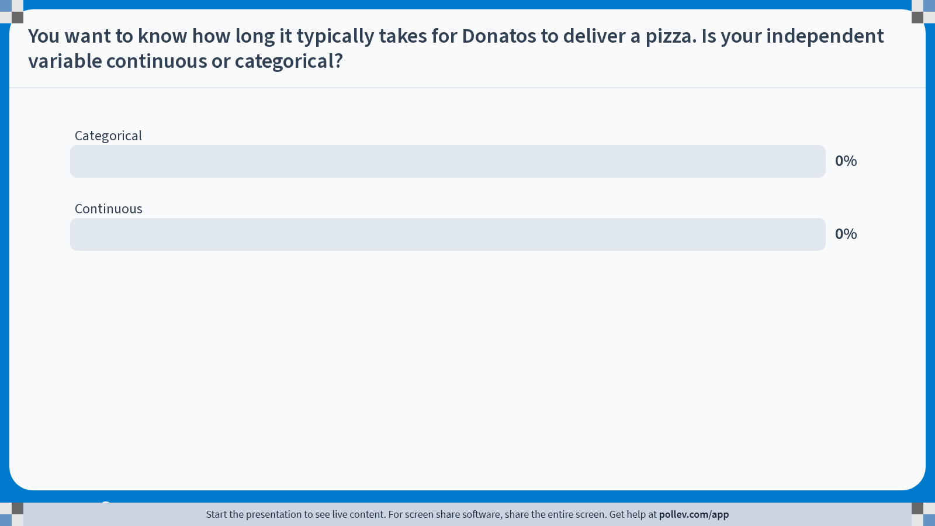
Notes:
Do not modify the notes in this section to avoid tampering with the Poll Everywhere activity. More info at polleverywhere.com/support You want to know how long it typically takes for Donatos to deliver a pizza. Is your independent variable continuous or categorical?
https://www.polleverywhere.com/multiple_choice_polls/G9jsjLPMLhLE5Ka45GdnW?state=opened&flow=Default&onscreen=persist

Slide 16
Types of plots to use for different types of data
Categorical
Bar chart
Pie chart
Box and Whisker Plot
Continuous
Line graph
Scatter Plot
Histogram

Slide 17
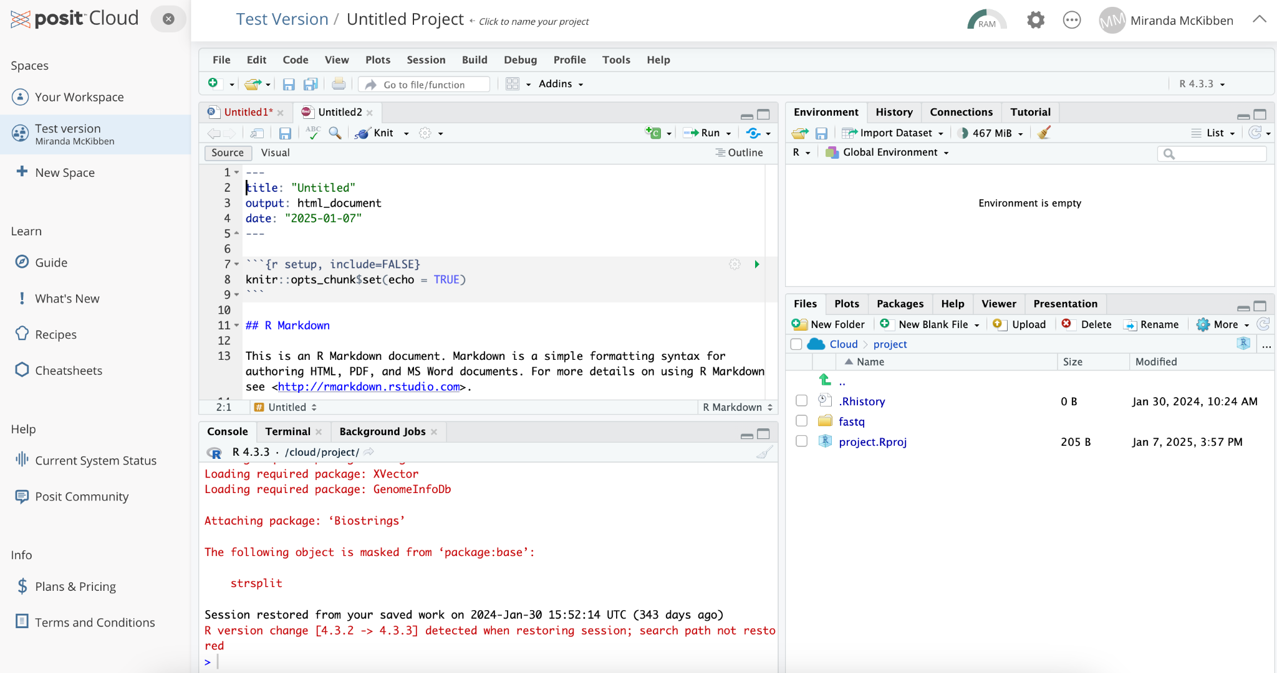

Slide 18
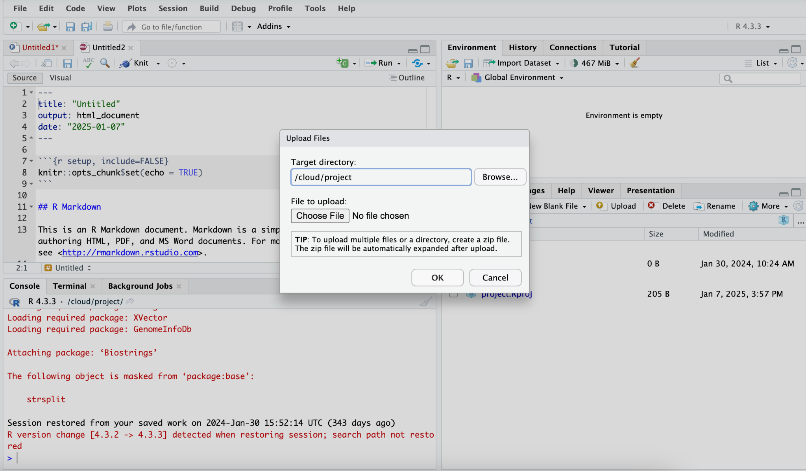

Slide 19
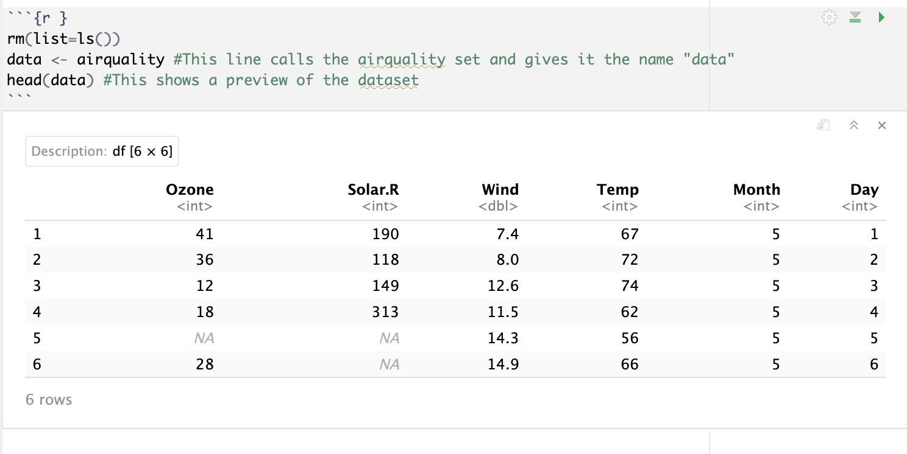

Slide 20
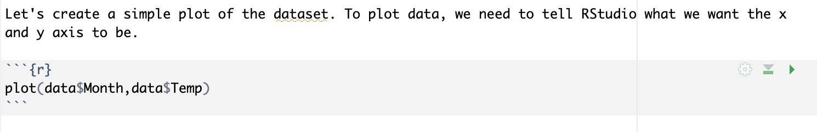

Slide 21
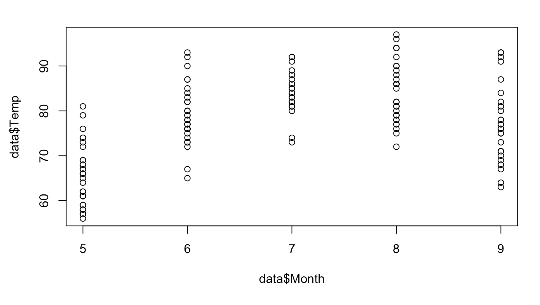

Slide 22
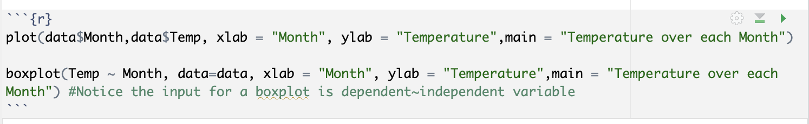
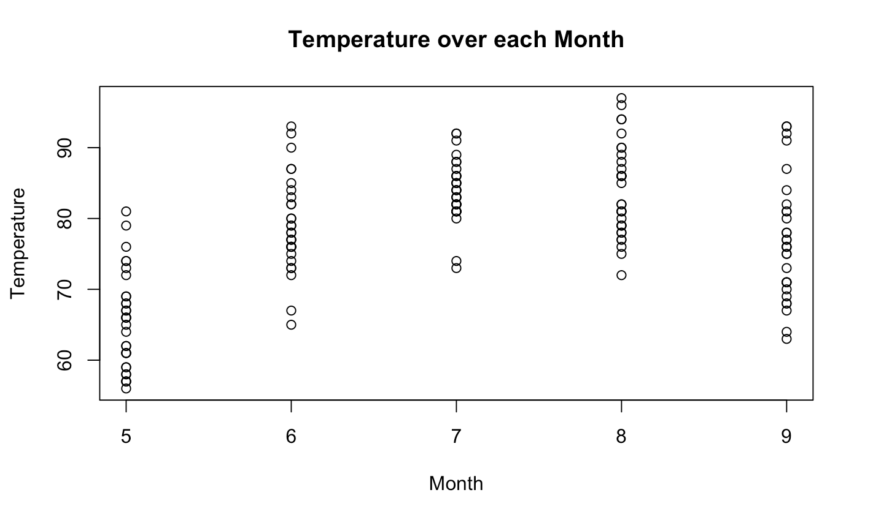
Notes:
This shows the scatterplot

Slide 23
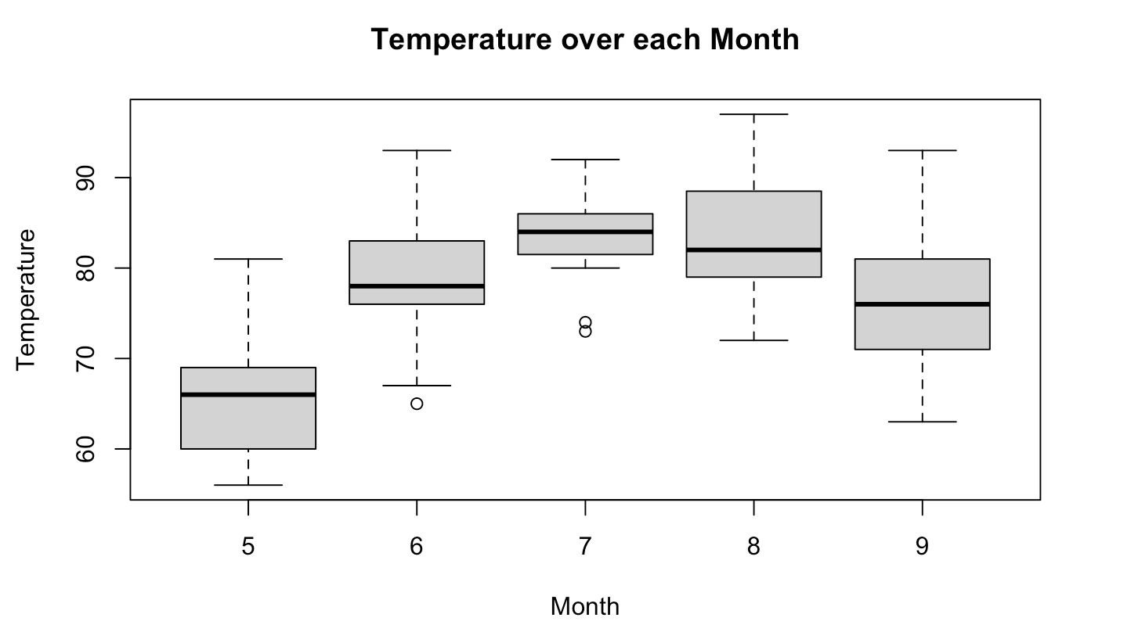
Notes:
This shows the boxplot

Slide 24
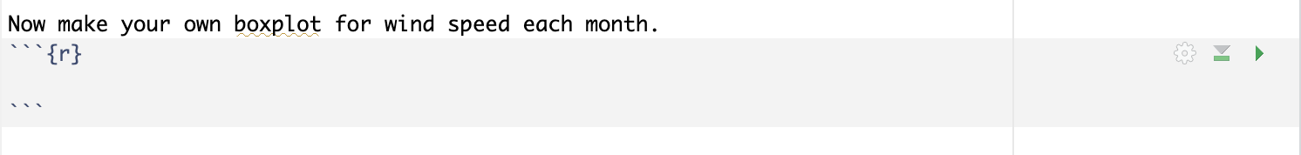

Slide 25
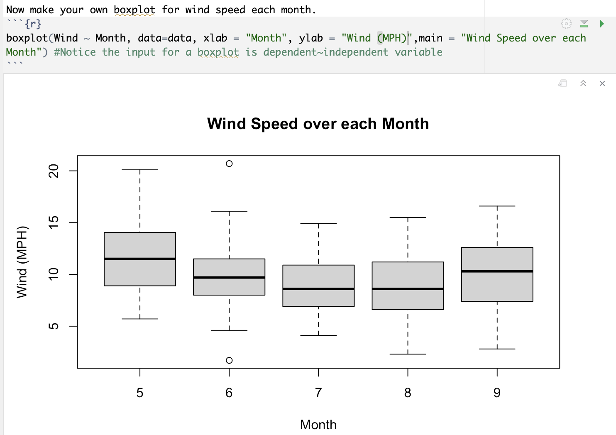

Slide 26
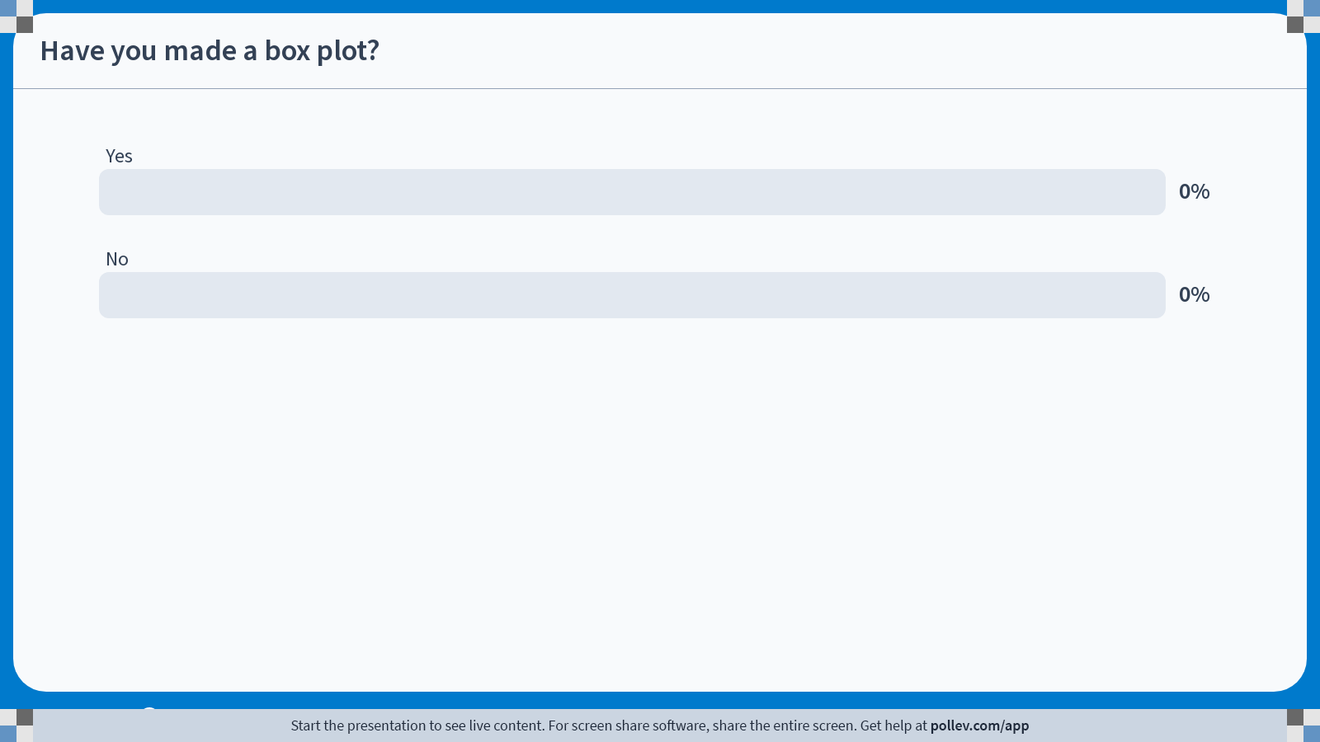
Notes:
Do not modify the notes in this section to avoid tampering with the Poll Everywhere activity. More info at polleverywhere.com/support Have you made a box plot?
https://www.polleverywhere.com/multiple_choice_polls/XCGt45e62KbVy7E6v8KzW?state=opened&flow=Default&onscreen=persist

Slide 27
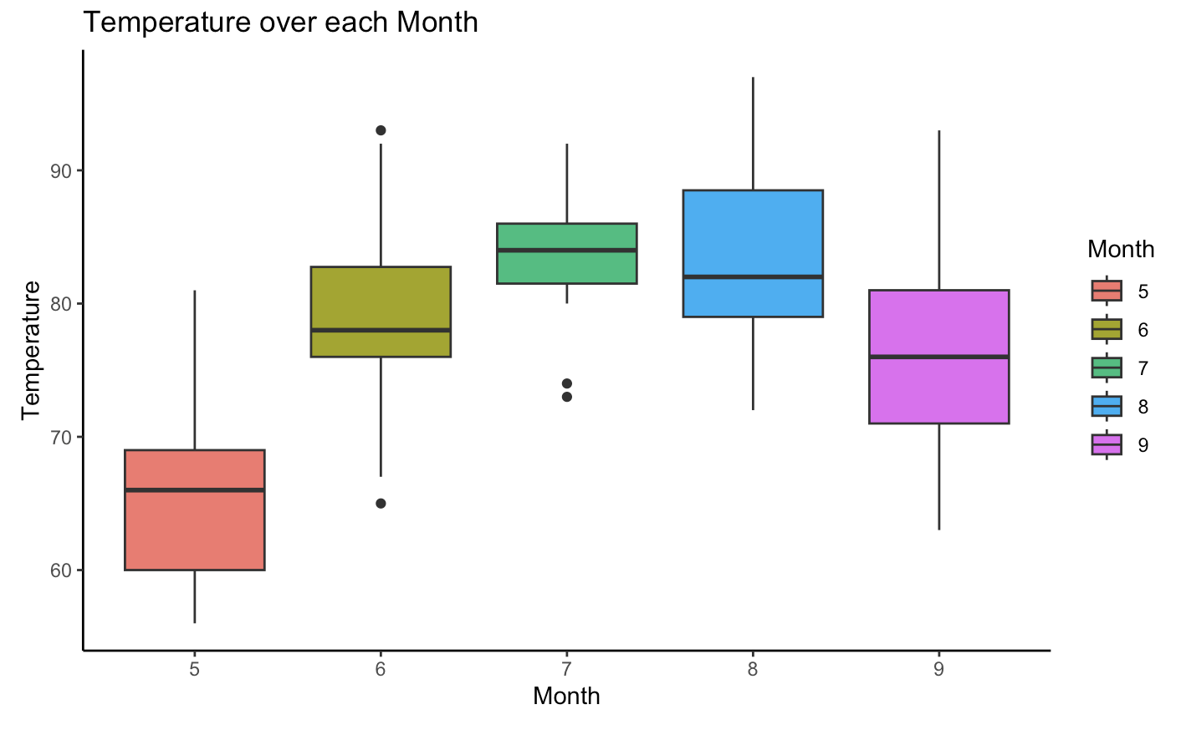

Slide 28
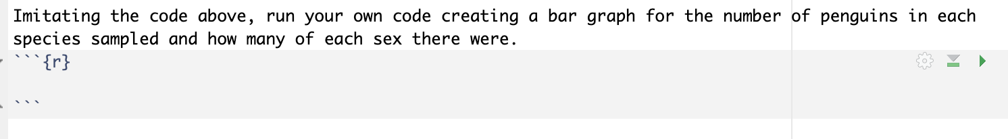

Slide 29
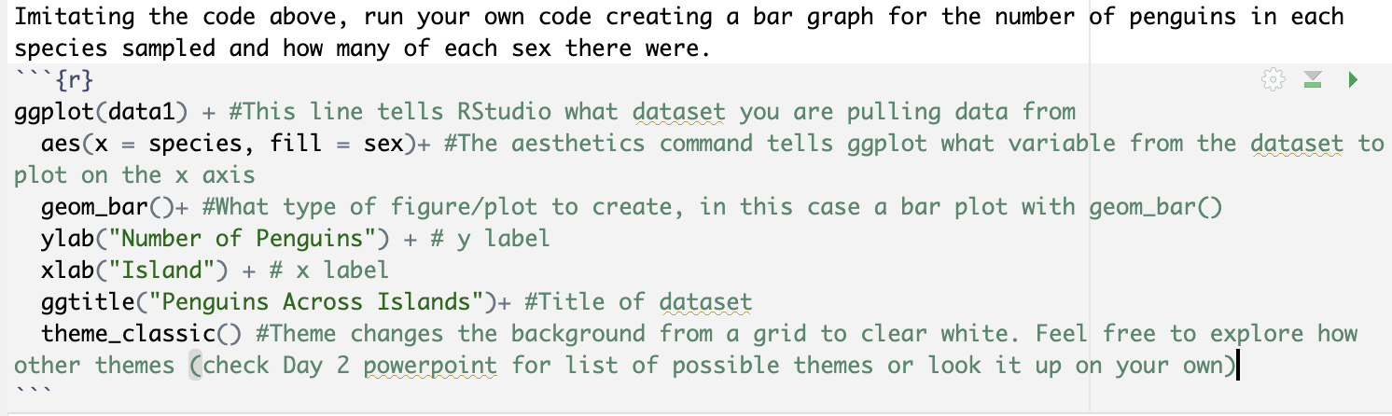
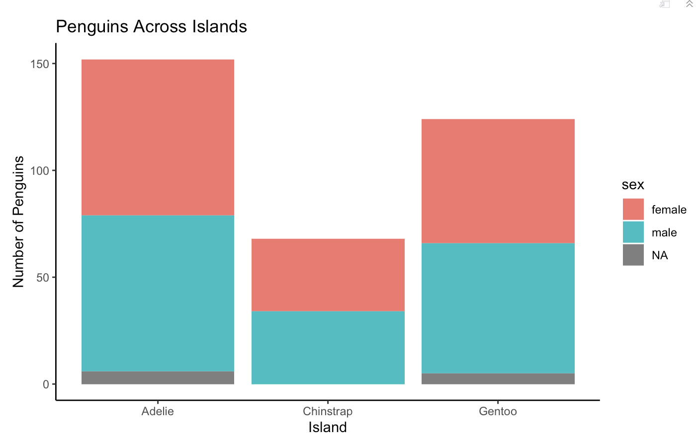

Slide 30
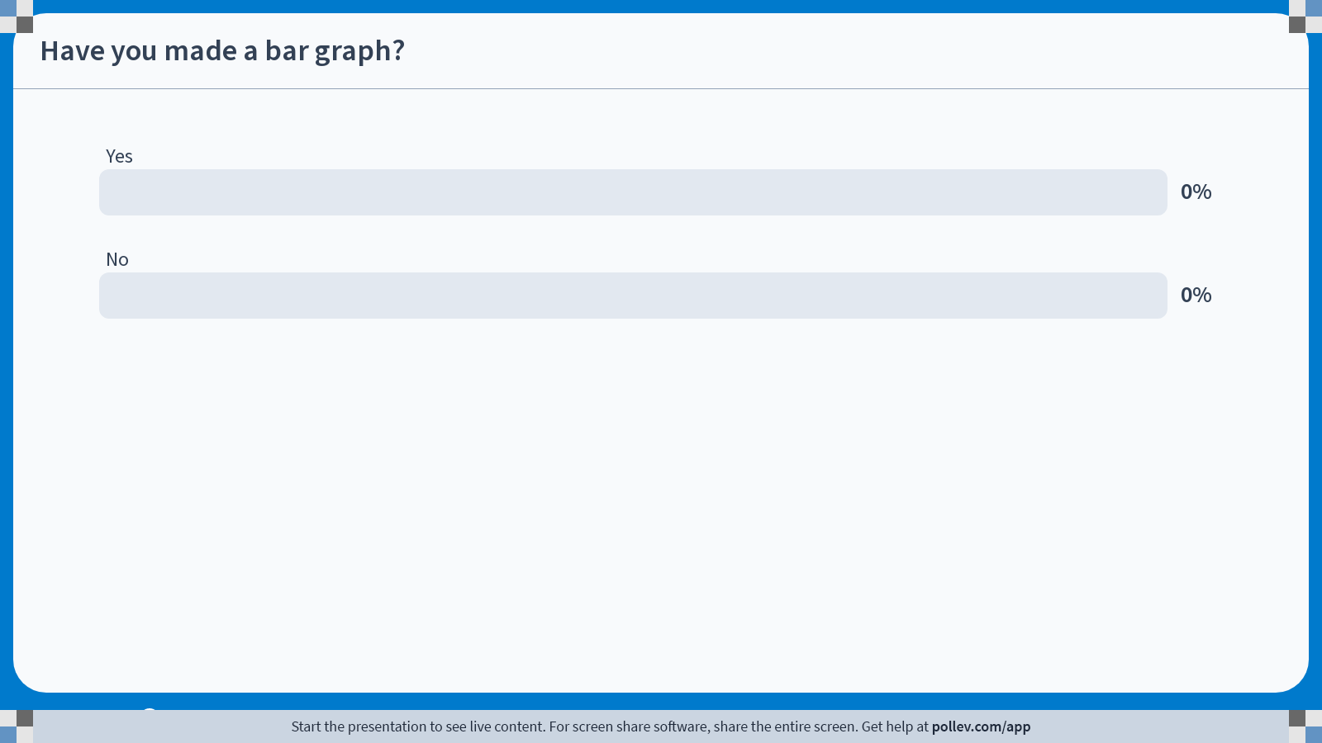
Notes:
Do not modify the notes in this section to avoid tampering with the Poll Everywhere activity. More info at polleverywhere.com/support Have you made a bar graph?
https://www.polleverywhere.com/multiple_choice_polls/mpOmeOUw9aknUjXn8BlZT?state=opened&flow=Default&onscreen=persist

Slide 31
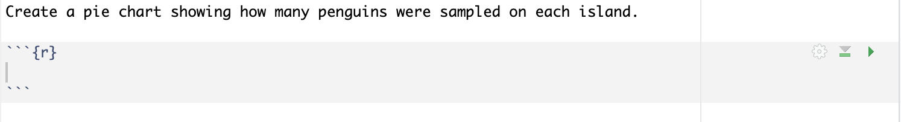

Slide 32
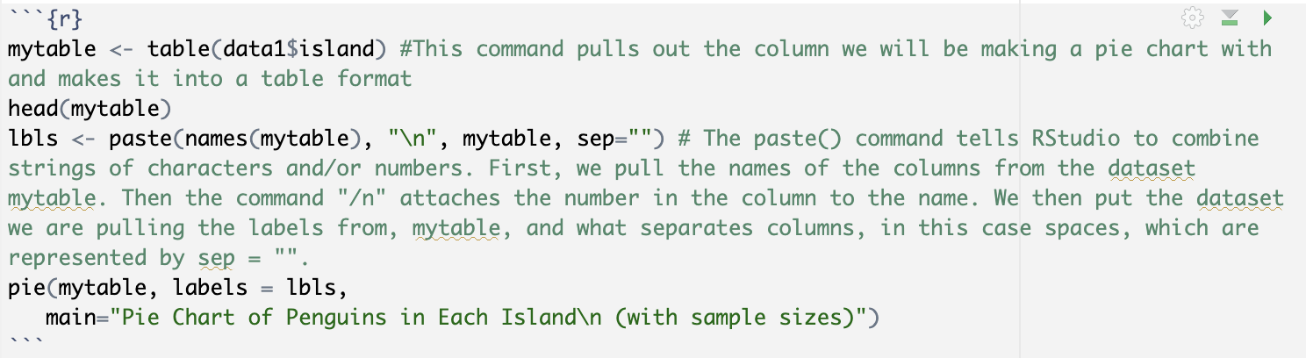
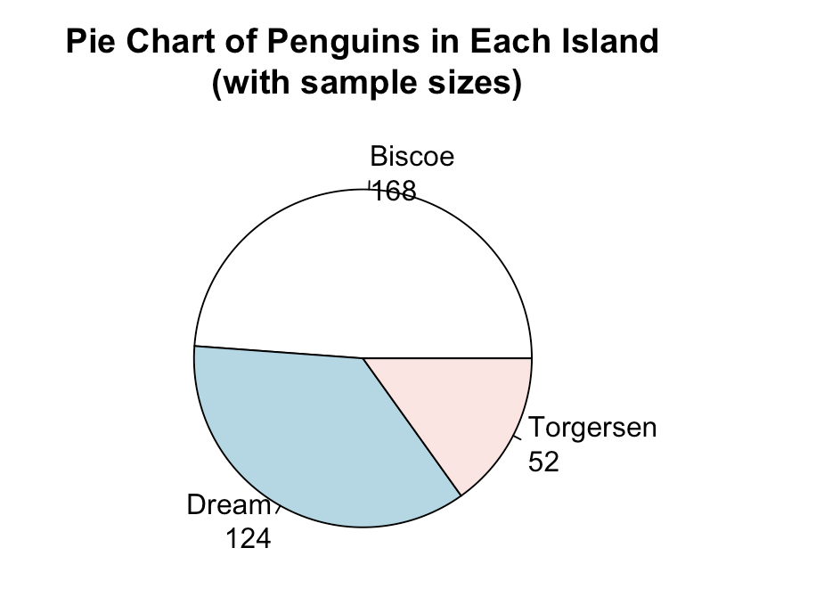

Slide 33

Notes:
Do not modify the notes in this section to avoid tampering with the Poll Everywhere activity. More info at polleverywhere.com/support Have you made a pie chart?
https://www.polleverywhere.com/multiple_choice_polls/R6lkaZFarr7JwhaPunNYA?state=opened&flow=Default&onscreen=persist

Slide 34
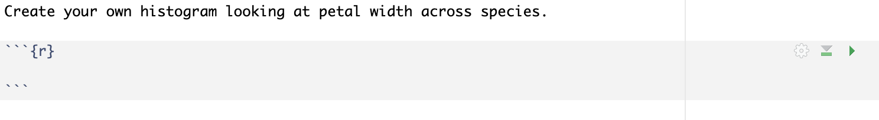

Slide 35
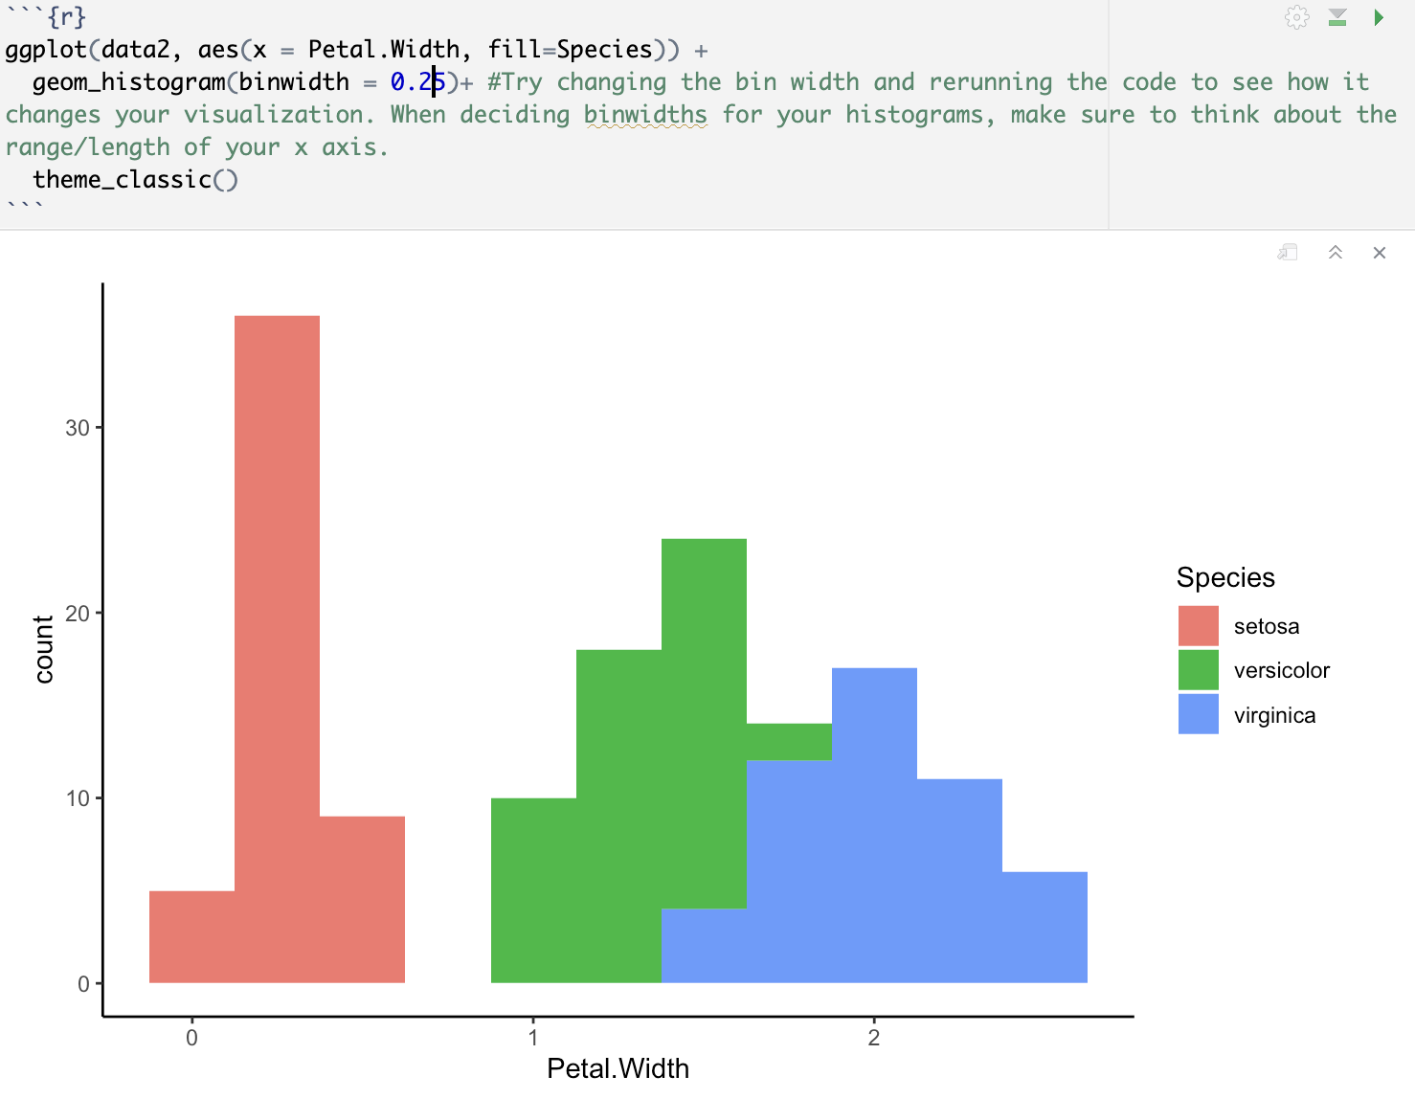

Slide 36
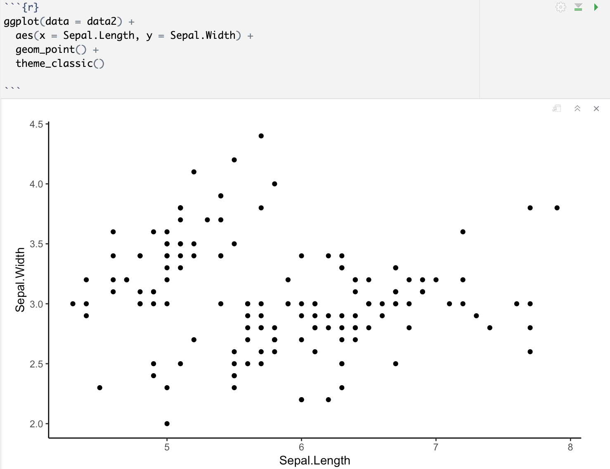

Slide 37
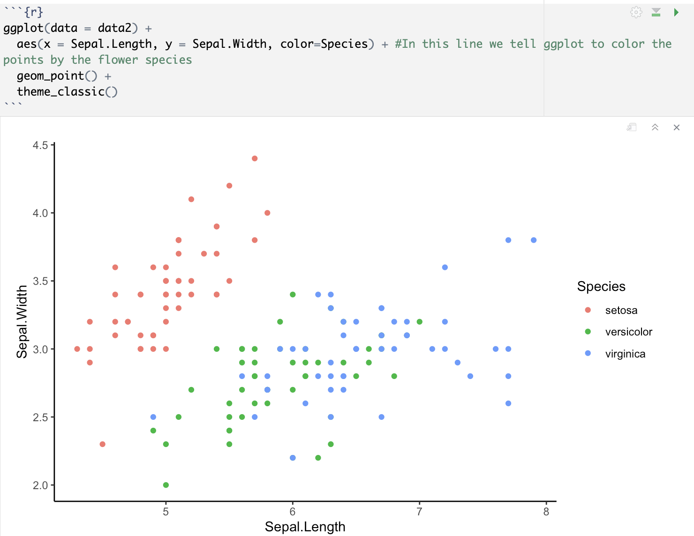

Slide 38
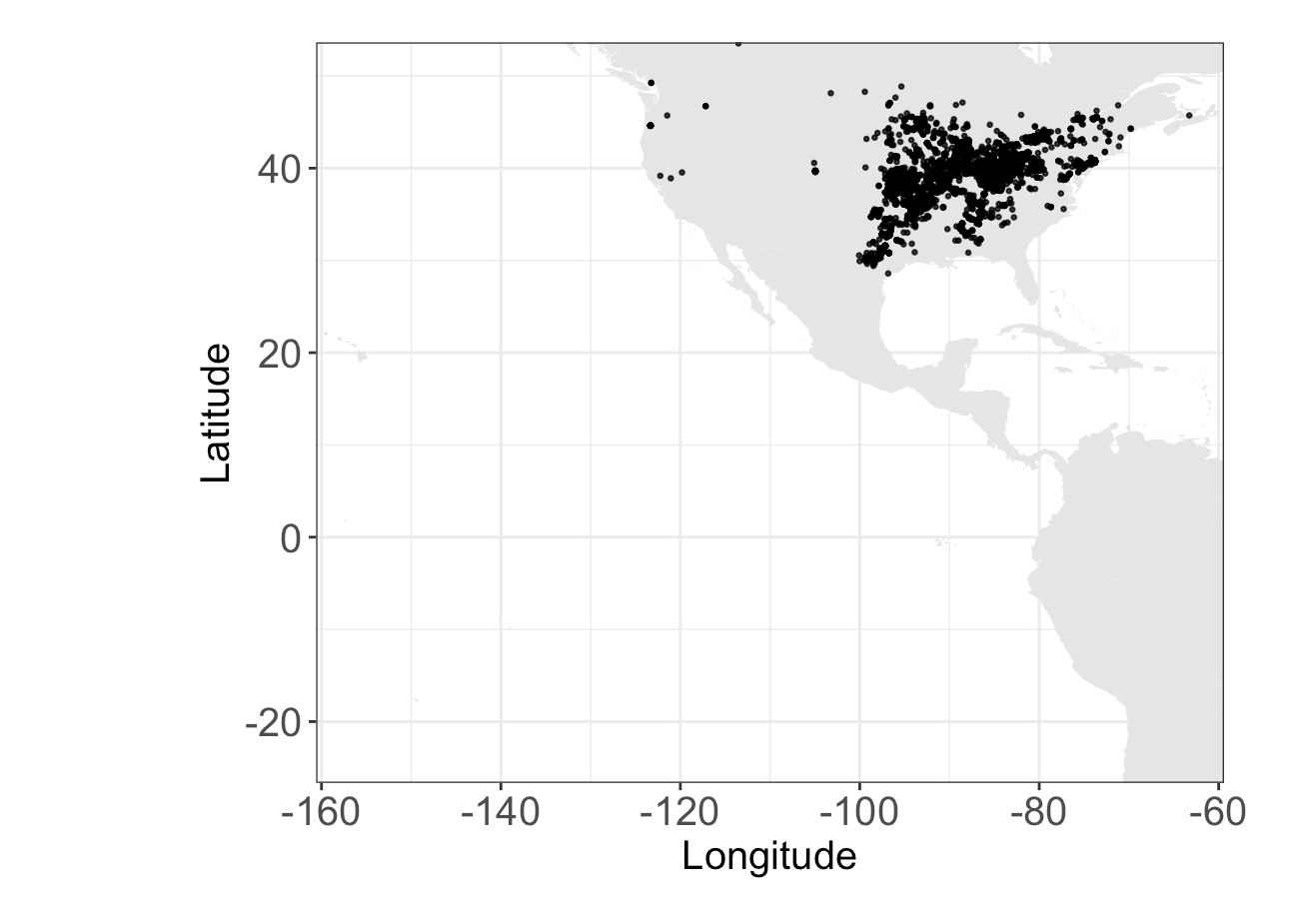

Slide 39
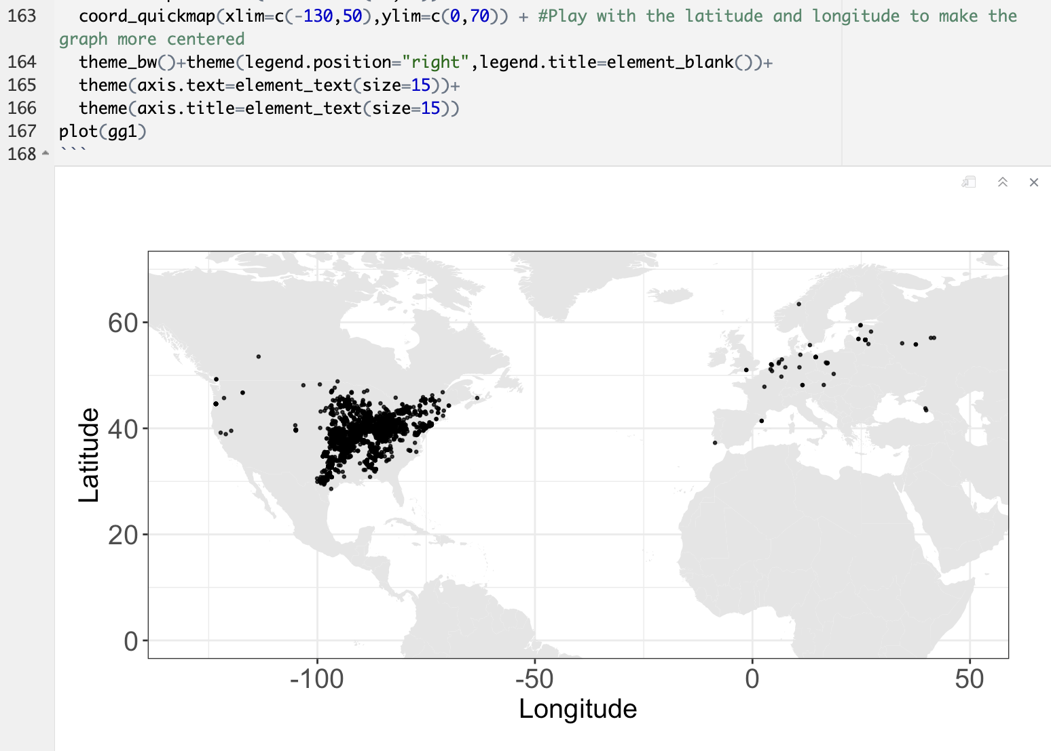

Slide 40
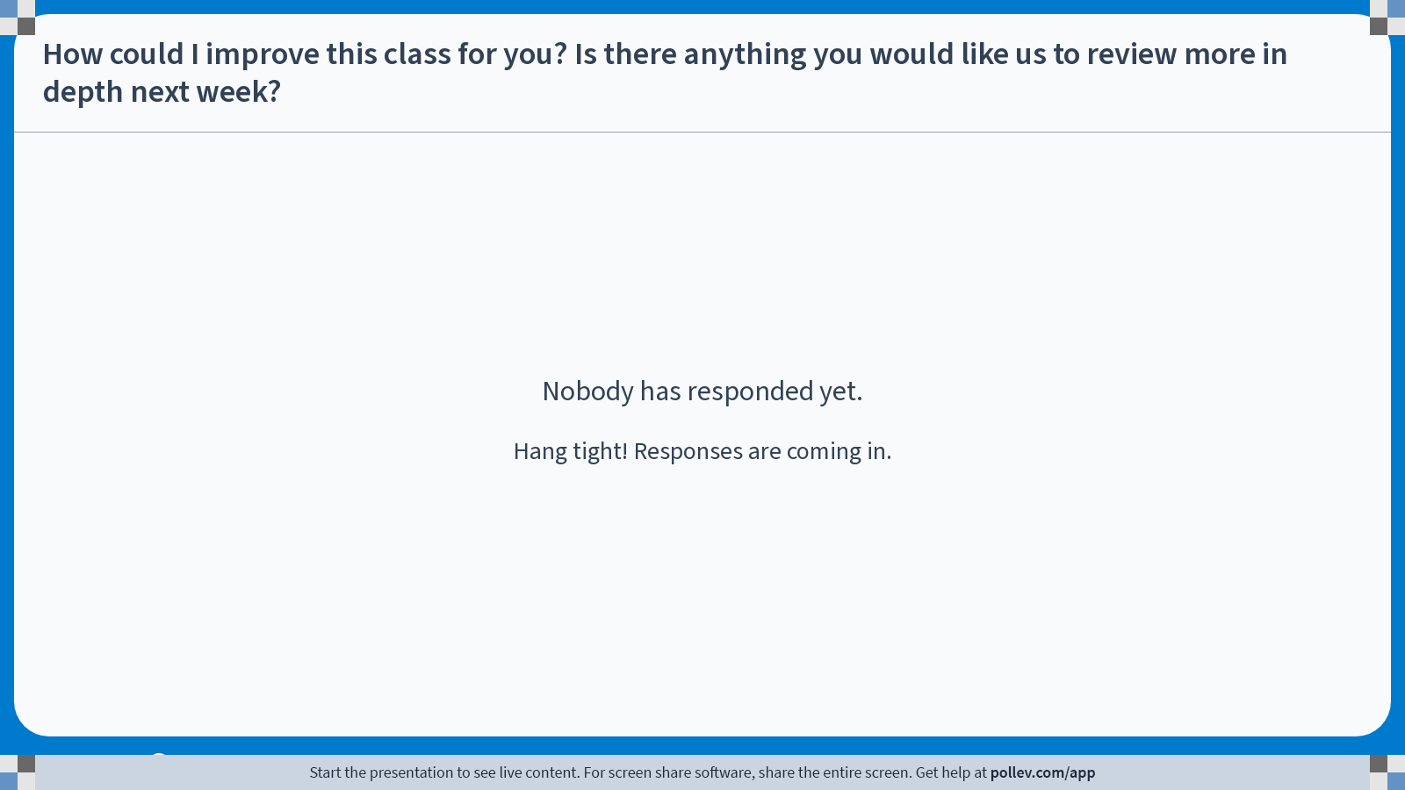
Notes:
Do not modify the notes in this section to avoid tampering with the Poll Everywhere activity. More info at polleverywhere.com/support How could I improve this class for you? Is there anything you would like us to review more in depth next week?
https://www.polleverywhere.com/discourses/ZVEP8soFI4zERRr6ZgLTl

